Slide 1
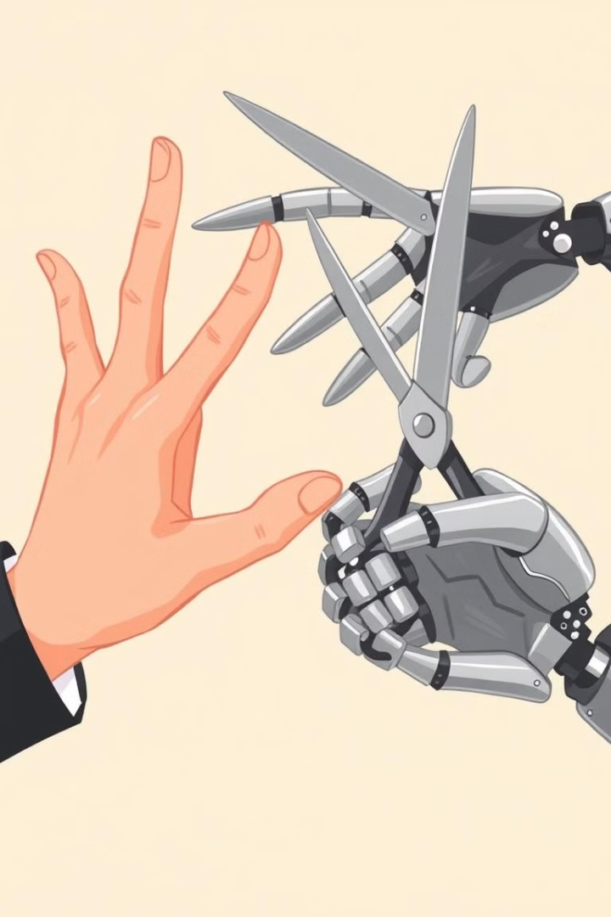
Rock-Paper-Scissors: Human vs. Computer
Ready to challenge the computer? Prepare for a strategic showdown with the classic game of Rock-Paper-Scissors.

Slide 2
Introduction to the Classic Game
Ancient Origins
Global Popularity
Rock-Paper-Scissors has roots in ancient Chinese culture, a game of hand gestures and strategy.
Today, it's enjoyed by people across the globe, a simple yet captivating game of chance and skill.

Slide 3

The Basics of Rock-Paper-Scissors
Rock
Paper
Scissors
Crushes scissors.
Covers rock.
Cuts paper.

Slide 4



How Computers Play the Game
Random Number Generator
1
Computers use random number generators to make selections.
Algorithm
2
A predefined algorithm assigns choices to numbers.
Outcome
3
The algorithm determines the computer's move.

Slide 5




Strategies for Beating the Computer
Pattern Recognition
Look for patterns in the computer's previous choices.
Counterplay
Play the winning move against the expected pattern.
Randomness
Mix up your choices to make the computer's prediction harder.

Slide 6

Common Tactics Used by AI Opponents
Previous Choice Bias
Predictive Algorithms
Some AIs might be programmed to favor a previous choice.
AIs can use complex algorithms to predict your next move.
Adaptive Learning
Some AIs learn from your choices, adapting to your strategy.

Slide 7




The Psychology of Rock-Paper-Scissors
Cognitive Bias
Reaction Time
Body Language
Humans often fall into patterns or overthink, making them predictable.
Faster reaction times can give a slight advantage in a quick game.
Subtle hints from your opponent can be interpreted to anticipate their choice.

Slide 8

Conclusion and Final Thoughts
Rock-Paper-Scissors remains a timeless game of chance and skill. Mastering the game requires strategic thinking, pattern recognition, and even a touch of psychology.

